Slide 1

Historical Source Analysis
This resource covers the key skill of SOURCE ANALYSIS as used in several topics, including
Iron Age and Neolithic Revolution in Britain
Elizabeth I
The Civil Rights Movement
Slavery and America
The Black Death
The French Revolution
The First and Second World Wars
The Cold War
China’s Qing Dynasty
The Vietnam War

Slide 2
LEARNING OBJECTIVES
At the end of the module, students should be able to:
Understand what historical sources are
Use the five Ws in source analysis
Be familiar with analysing written and image sources
RESOURCE CONTENT
Types of historical sources
Analysis of written and images sources
Examples of source analysis in various topics
Practice Assessment

Slide 3


HISTORICAL SOURCES
Before applying source analysis, we must first know what a historical source is. Historical resources include documents, paintings, audio recordings, images, motion pictures, artefacts, inscriptions and oral history. These sources let us know about historical information at the most basic level. There are two main types: primary and secondary sources.
HISTORICAL SOURCES
Primary source
Secondary source
A primary source is material that originates from the past. This could be archaeological finds such as stone inscriptions, cartographic testimonies and literary descriptions. For example, a Roman coin excavated from the Mediterranean that was made by the Romans in ancient times.
A secondary source is a document or recording of comments and information about the past. Unlike a primary source (which is an original source), a secondary source gives information about a primary source. For example, a Roman coin reproduced in 2020. Most secondary sources are written by trained scholars and historians.

Slide 4

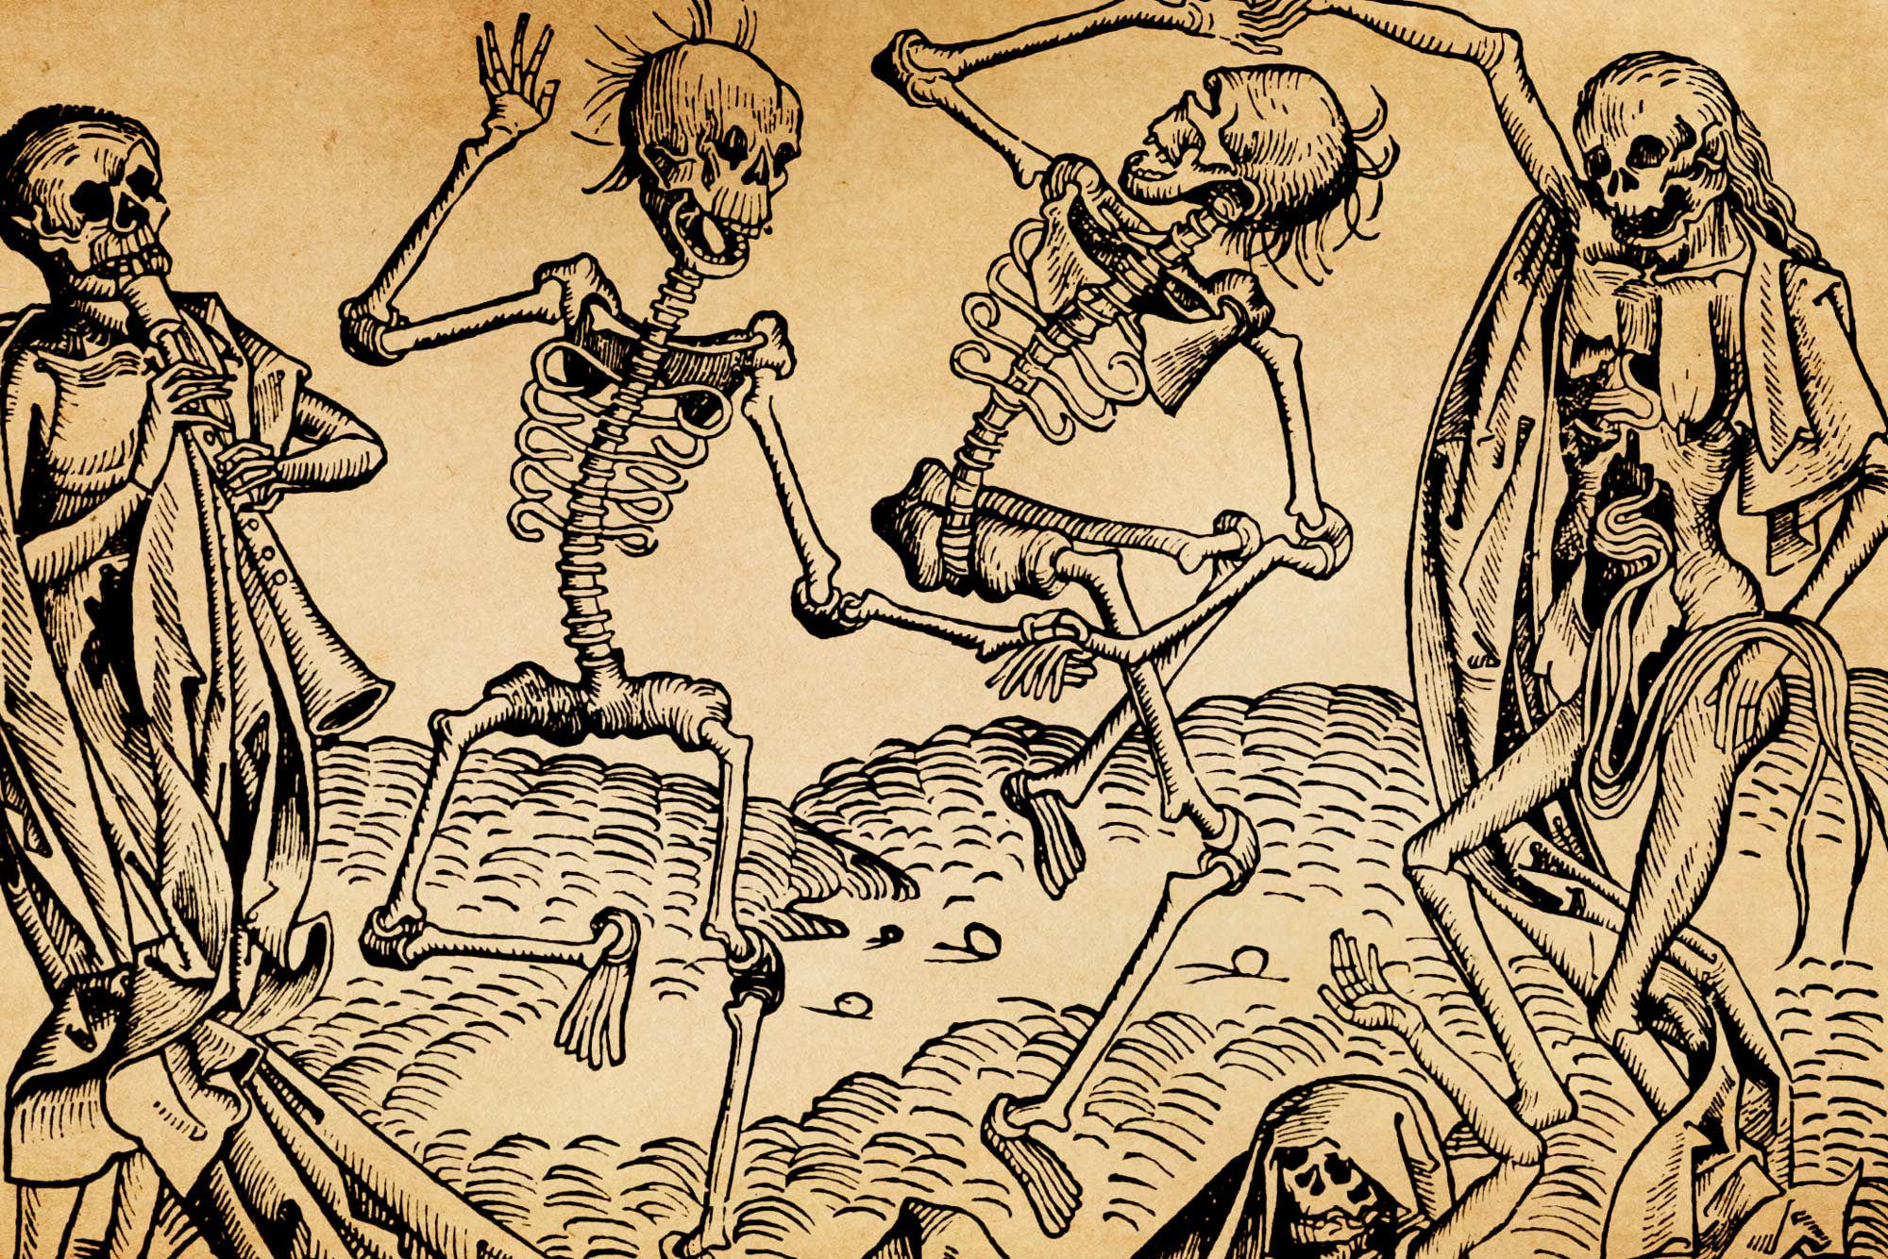
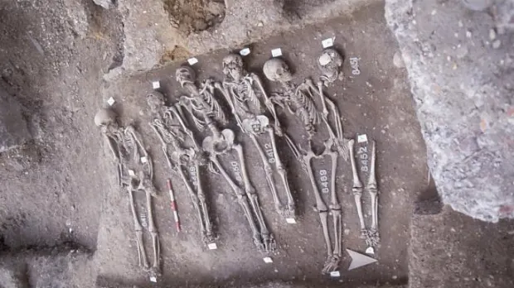
Primary Source
As immediate and first-hand accounts, primary sources are made by people who had a direct connection with the topic. Additional examples include original texts of laws, diaries, letters, speeches and interviews.
Inspired by the Black Death, The Dance of Death was a common painting motif in the late medieval period. (Illustrations from the Nuremberg Chronicle by Hartmann Schedel (1440-1514))
An example of a primary source is this plague pit from London’s East Smithfield. This burial pit was used at the height of the Black Death in 1348
Notes:
Image retrieved from: https://www.history.com/news/is-the-black-death-the-ancestor-of-all-modern-plagues
https://news.virginia.edu/content/qa-new-research-reveals-political-changes-wrought-black-death

Slide 5

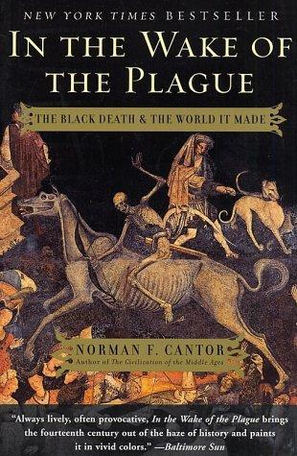
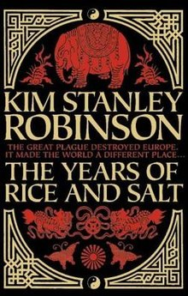
Secondary Source
As mentioned, trained scholars and historians create secondary sources. This involves analysis, interpretation, generalisation and evaluation of the primary source. For example, The Dance of Death in the previous slide would be a primary source if the person who made it lived during the plague. However, it could also be a secondary source if it was simply someone’s interpretation of the said event.
Meanwhile, books about the Black Death such as In the Wake of the Plague: The Black Death and the World It Made (2001), The Years of Rice and Salt (2002) and The Black Death and the Transformation of the West (1997) are examples of secondary sources.
Book covers of In the Wake of the Plague: The Black Death and the World It Made (2001) and The Years of Rice and Salt (2002)
Notes:
Image retrieved from: https://www.goodreads.com/book/show/173258.In_the_Wake_of_the_Plague
https://en.wikipedia.org/wiki/The_Years_of_Rice_and_Salt

Slide 6





SOURCE ANALYSIS
Source Analysis is the process of breaking a topic into smaller or categorised parts to gain a better understanding of it. This technique was used in ancient Greece, but only became a formal concept in the works of René Descartes and Galileo Galilei. In analysing a historical source, think of the five Ws - who, what, why, when and where.
Who made the source? Identify his/her relation with the source. It is a primary or secondary source?
What information does the source provide or what is it trying to imply?
5Ws
Why was the source made? Was it made to persuade people of a certain opinion or the public?
When was it made? Identify the historical time context of the source.
Where was it made? Identify the historical location of the source.

Slide 7


Test the five Ws!
Analyse the statement below, made by Oliver Cromwell to Colonel Valentine Walton in 1644:
“We study the glory of God, and the honour and liberty of Parliament, for which we unanimously fight, without seeking our own interests… I profess I could never satisfy myself on the justness of this war, but from the authority of the Parliament to maintain itself in its rights; and in this cause I hope to prove myself an honest man and single-hearted.”
In analysing written sources or statements, take note of the following:
Events happening at the time it was written
Background information about the author to perceive intention and audience
Keywords used
Overall theme of the source based on when and where it was written
Actual topic is located in KS3 Area 2 English Civil Wars, Interregnum, Cromwell, Restoration, and Parliament. Similar specification can also be found in GCSE resources.
SOURCE A
After identifying the source, put it in context, consider the author’s purpose, evaluate the information gathered.

